Slide 1
Design Patterns of Microservices

Slide 2
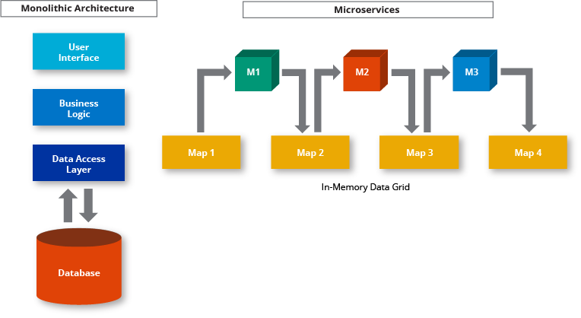
How Do Microservices Architectures Work?
Microservices Architecture Diagram:
Microservices Architecture vs Monolithic Architecture

Slide 3
Principles Used to Design Microservice Architecture
Independent & Autonomous Services
Scalability
Decentralization
Resilient Services
Real-Time Load Balancing
Availability
Continuous delivery through DevOps Integration
Seamless API Integration and Continuous Monitoring
Isolation from Failures
Auto-Provisioning

Slide 4
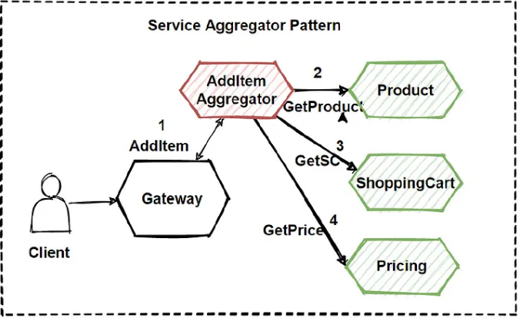
Aggregator

Slide 5
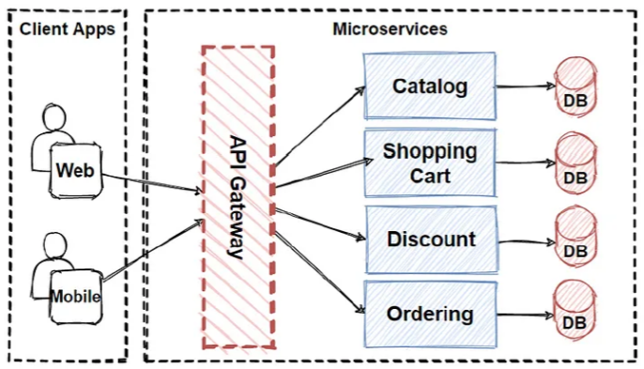
API Gateway

Slide 6
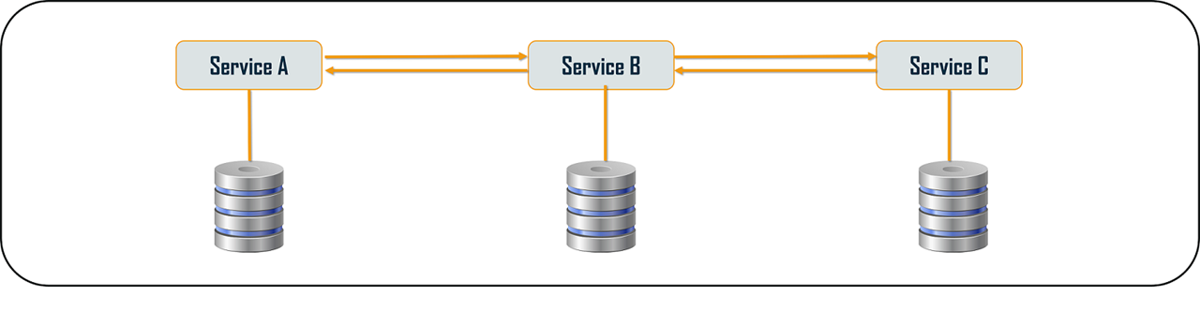
Chained or Chain of Responsibility

Slide 7
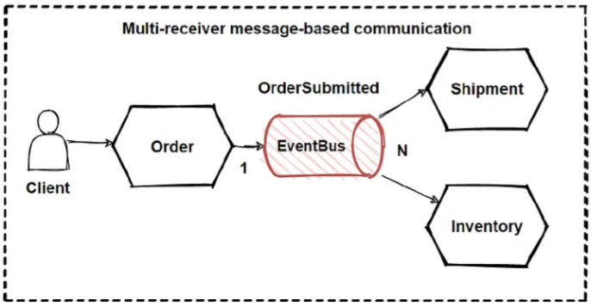
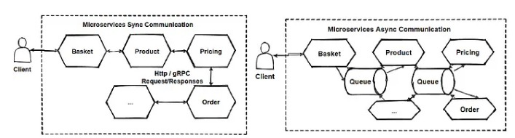
Asynchronous Messaging

Slide 8
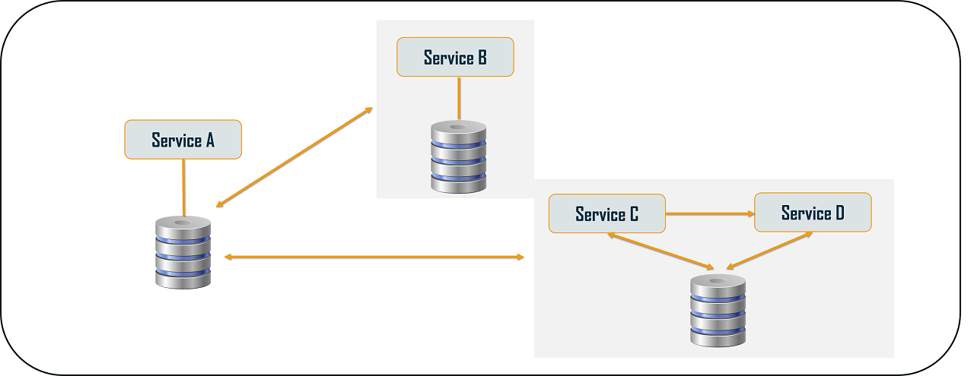
Database or Shared Data

Slide 9
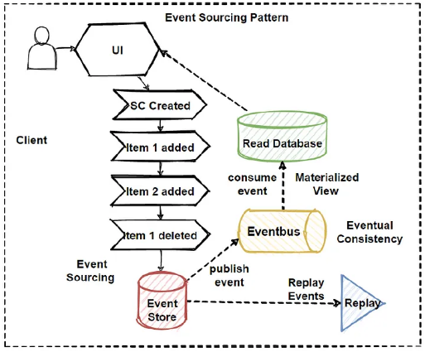
Event Sourcing

Slide 10
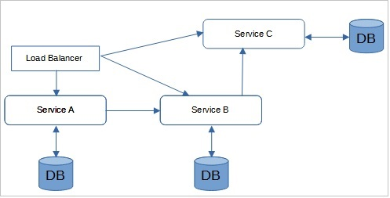
Branch

Slide 11
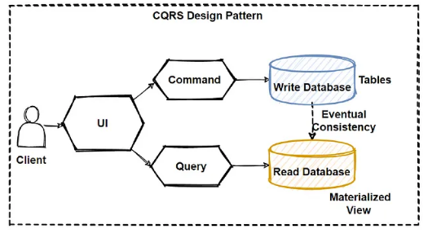
Command Query Responsibility Segregator

Slide 12
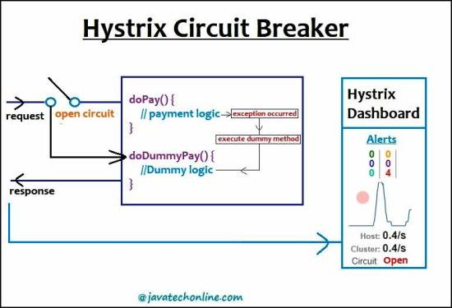
Circuit Breaker

Slide 13
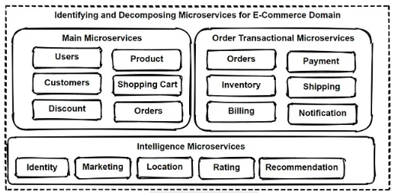
Decomposition

